Slide 1

Brightcove Gallery Essentials
Bob Bailey
bbailey@brightcove.com

Slide 2
Agenda
Introduction
Before you Get Started
Gallery Settings
Creating a New Site
Adding Objects to Pages
Adding Video to a Site
Setting Site Properties
Previewing & Publishing a Site
Gallery Reports

Slide 3
Introduction to Gallery

Slide 4
What is Gallery?
Brightcove Gallery enables marketers to create engaging video portal experiences with best practices for SEO, responsive design, social sharing and conversion all in a single solution that can be implemented and updated in just minutes
Integrates closely with Video Cloud
All of the pages have a unique, addressable URL, and include video site maps and Schema.org tags
No technical resources required
Over 100 out-of-the-box templates
Responsive design looks great on any device
Social sharing features to drive more traffic

Slide 5
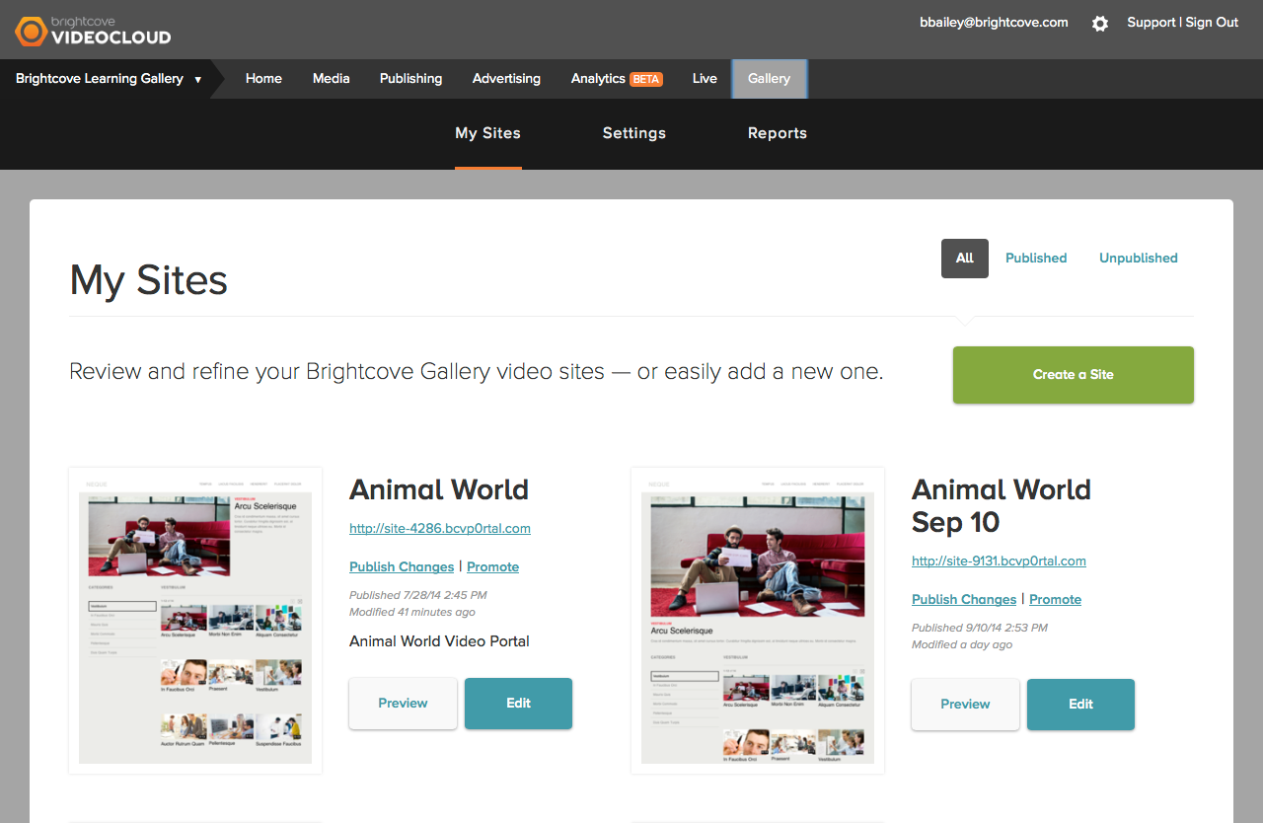
Navigating the Gallery Module

Slide 6
Before You Get Started

Slide 7
Before You Get Started
We recommend doing a few things before you get started using Gallery:
Create dedicated player(s) for your Gallery sites
Organize your video content in the Media module
Determine which Gallery template to use

Slide 8
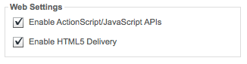
Creating a Dedicated Player(s)
You can set a default player at the account level to be used by all sites or…
Override the account level player and use a different player for each site
Having a dedicated player makes it easier to track Gallery activity in analytics
Use a single video player template
Enable these settings
Note: If these settings are not enabled, your player will not appear inside the Gallery module.

Slide 9
Organizing Your Video Content
Videos on Gallery sites are organized into Collections
Collections comprised of:
Playlists
Tags
Custom Fields
Search criteria
Think about how your content will be organized on your site
Are your videos tagged properly?
How are the videos tagged?
Create playlists to organize content
Having your content organized will save you time once you start building your site

Slide 10
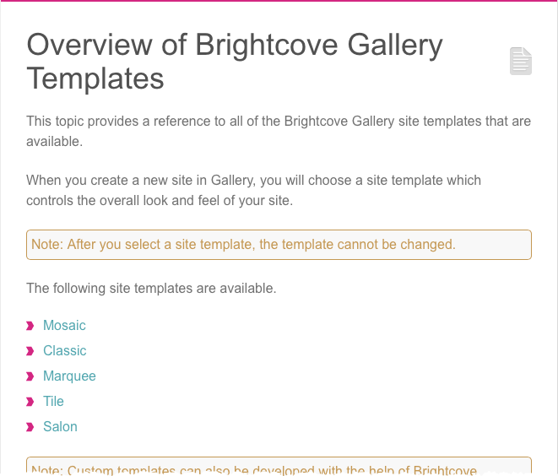
Determining which Gallery template to use
All Gallery sites are based upon a template
Gallery provides a set of templates “out of the box”
Templates control overall look and feel of the site
Use the documentation and look at the samples

Slide 11
Gallery Settings

Slide 12
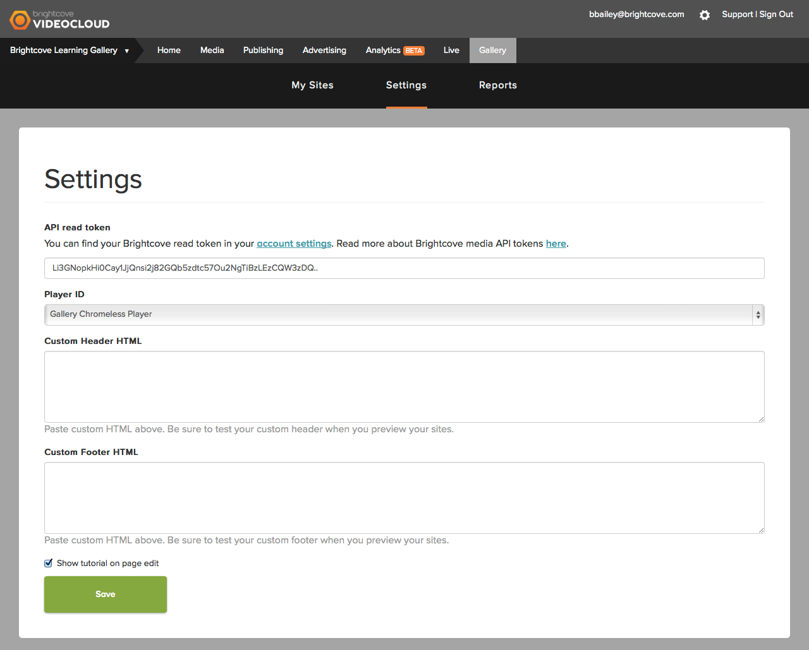
Configuring Gallery Settings
Gallery must be configured with your API read token and Player ID

Slide 13
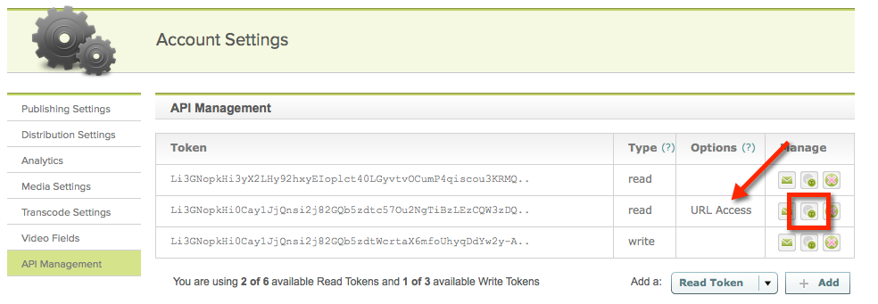
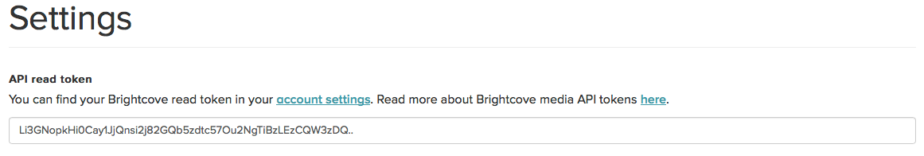
Configuring API Read Token
Gallery requires your Video Cloud API read token so it can access the videos and playlists in your account
To configure the API read token:
Click the account settings link or go to Account Settings > API Management
Copy the read token with URL Access
Note: Make sure you use the read token with URL Access.

Slide 14

Configuring the Player ID
Select an account level player
This player will be used on all sites unless a site-level player is selected
Note: If your player does not appear in the drop down list, make sure the player properties are set correctly

Slide 15
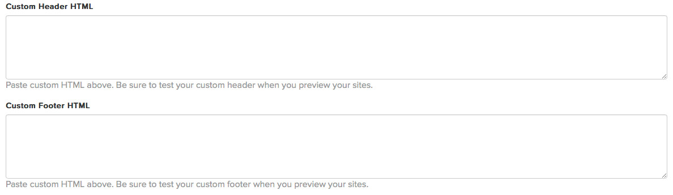
Custom Header and Footer
Provide HTML to use for the header and/or footer
Provides the ability to customize your Gallery site so it more closely matches the look and feel of your corporate sites

Slide 16
Creating a New Site

Slide 17
Creating a New Site
To create a new site, click Create a Site

Slide 18
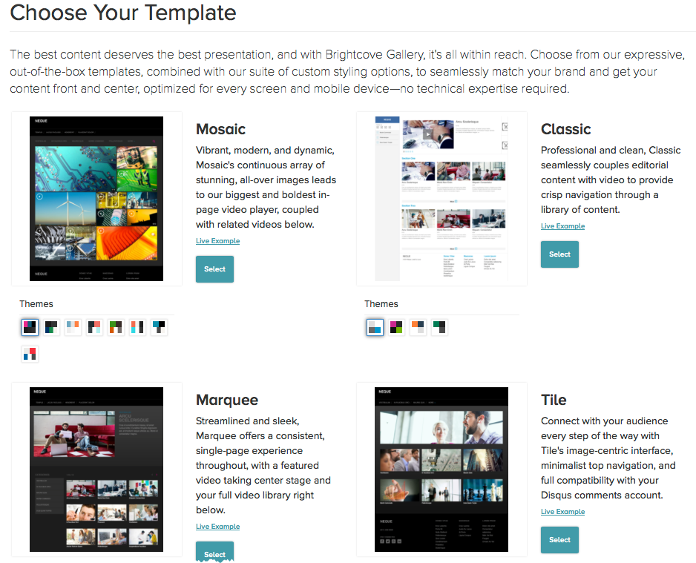
Creating a New Site
Select a template and a style
Styles can be changed later, templates can’t

Slide 19
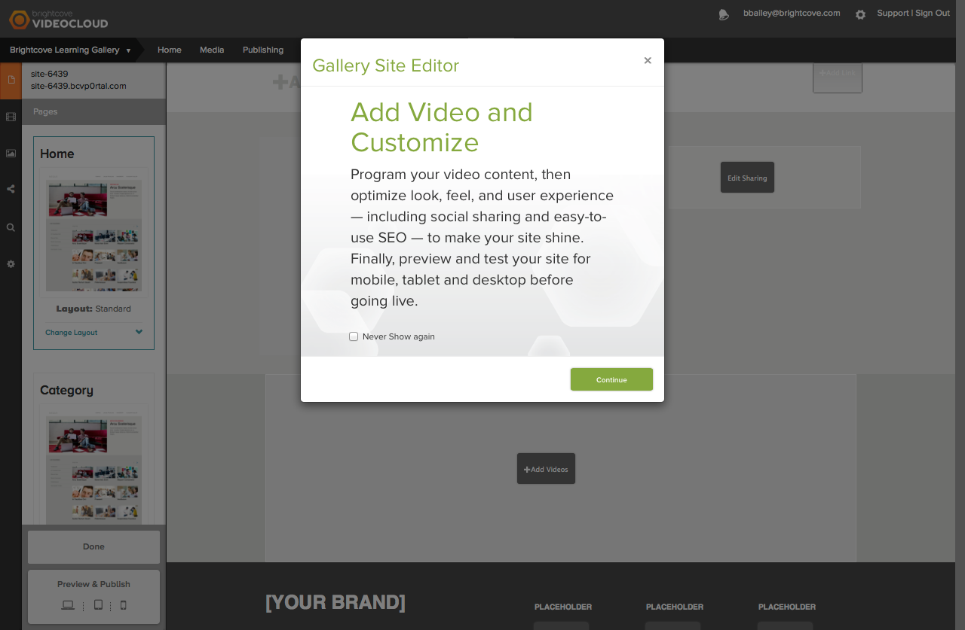
Gallery Site Editor
Used to add videos and customize the site

Slide 20
Adding Objects to Pages

Slide 21
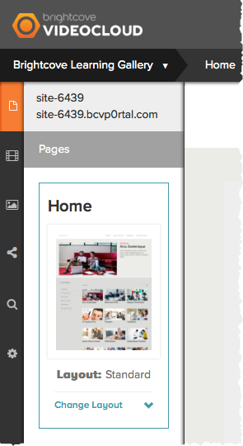
Page Navigation
Based upon the template that is selected, a set of pages templates will be available
Click on the page thumbnail to view/edit the page contents

Slide 22
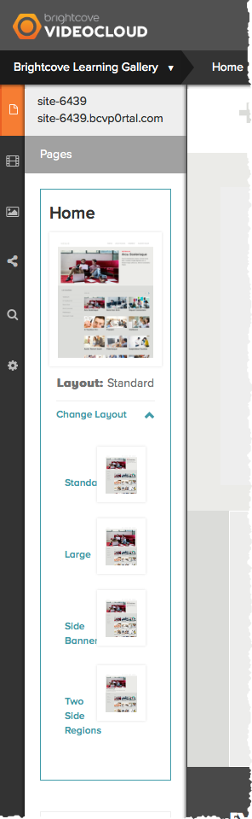
Editing the Player Layout
Some page templates provide the ability to change the player layout
Click Change Layout and select a new layout

Slide 23
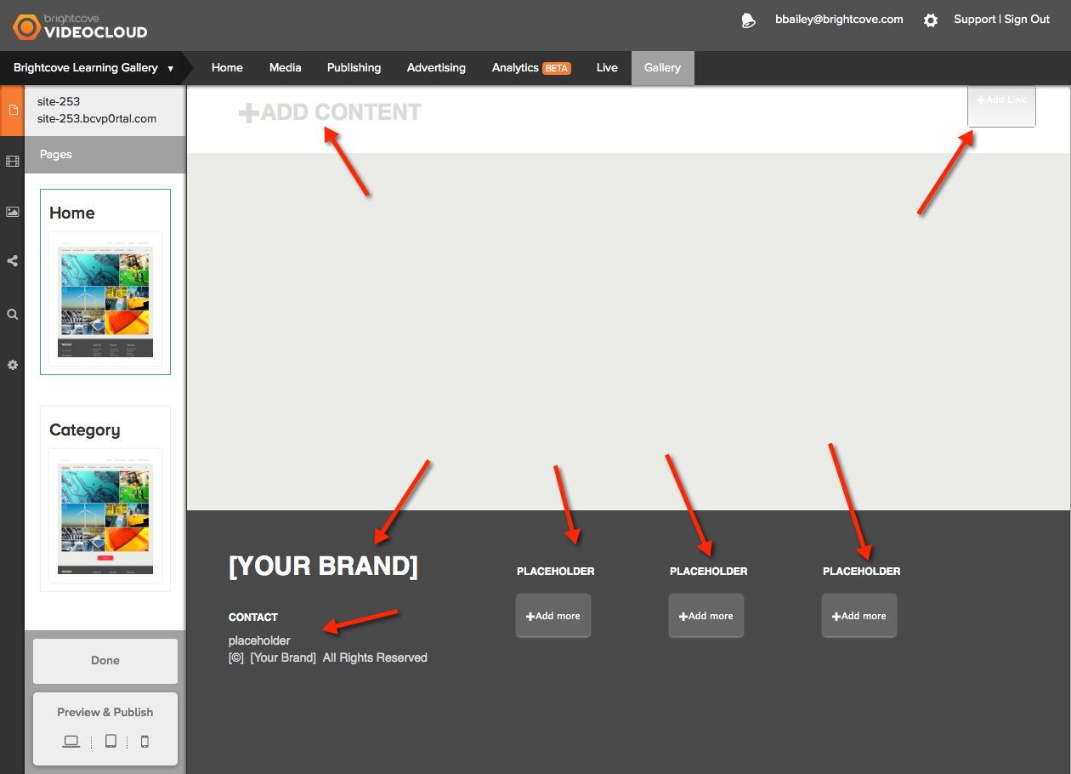
Editing the Page Content
Placeholders on the page indicate where images/text can be added
To add content, click a placeholder

Slide 24
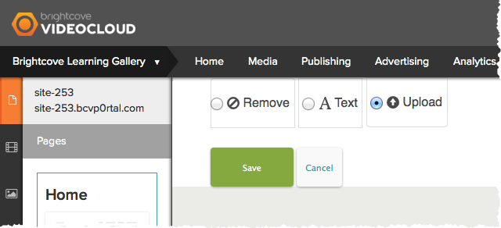
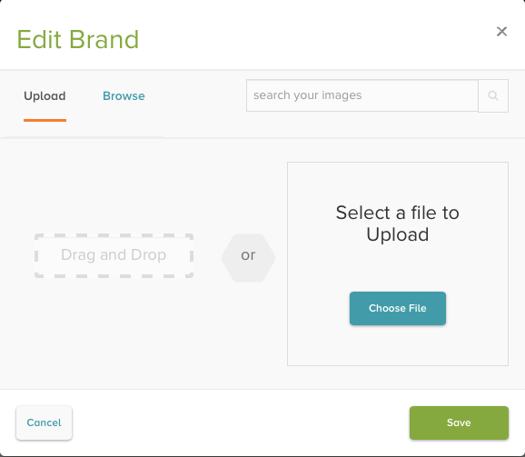
Adding an Image
Click a placeholder
Select Upload and then Save to add image placeholder
Click +Add Photo link to browse and select an image

Slide 25
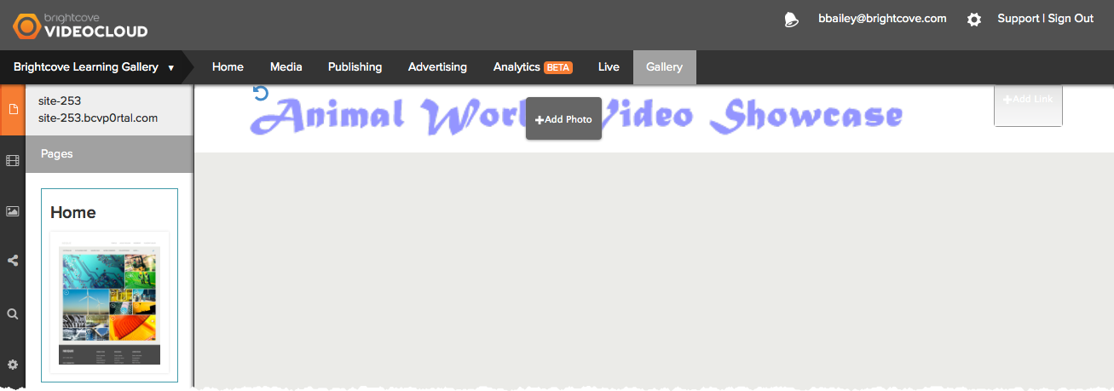
Adding Text
Changes made to the page will appear real-time

Slide 26
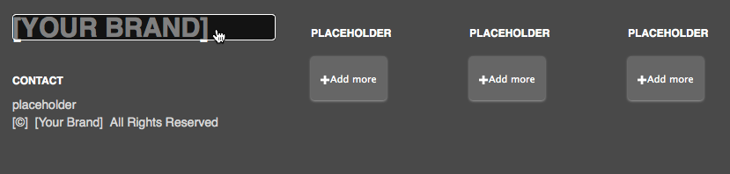
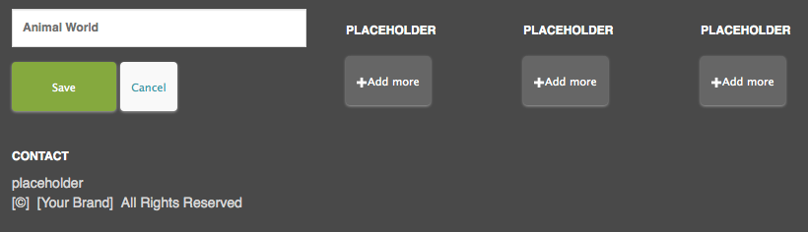
Adding Text
Click a text placeholder
Enter the text

Slide 27
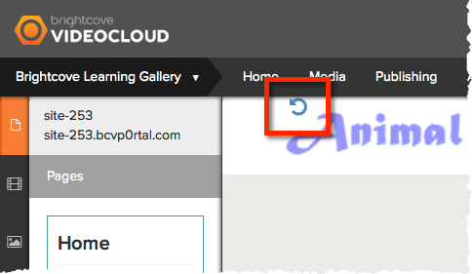
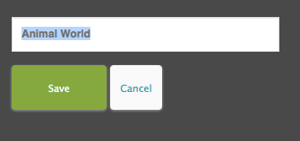
Deleting Objects
Click chasing arrows to remove an image
Clear text and then Save

Slide 28
Adding Video to a Site

Slide 29
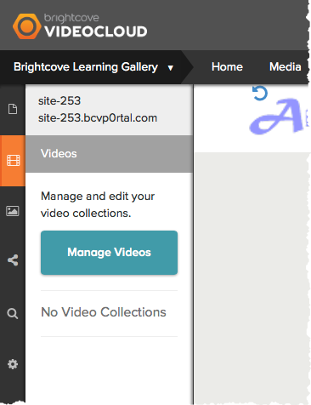
Adding Video to a Site
Click the Videos icon
Click Manage Videos
Videos are organized into collections

Slide 30
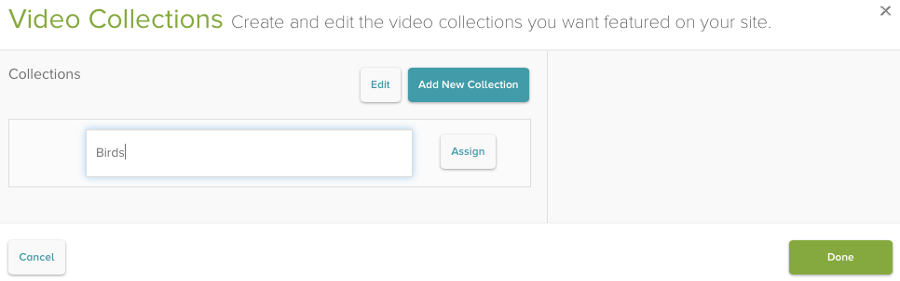
Creating a Collection
Click Add New Collection
Enter name for the collection
Click Assign to assign videos to the collection

Slide 31
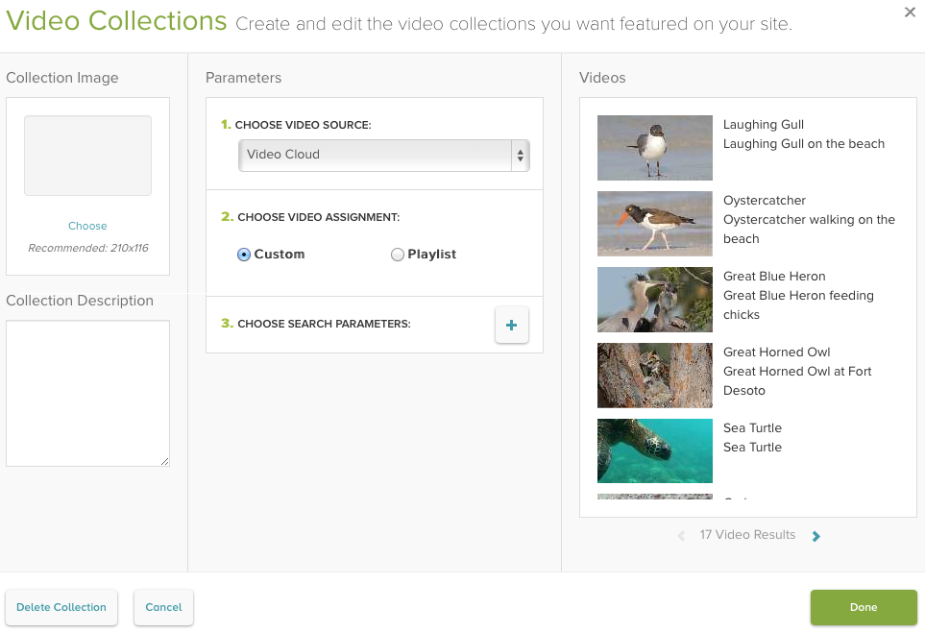
Creating a Collection
Choose a video assignment
Custom
Videos added to the collection based upon tags, search terms or custom fields
Playlist
Videos added to collection based upon a playlist

Slide 32
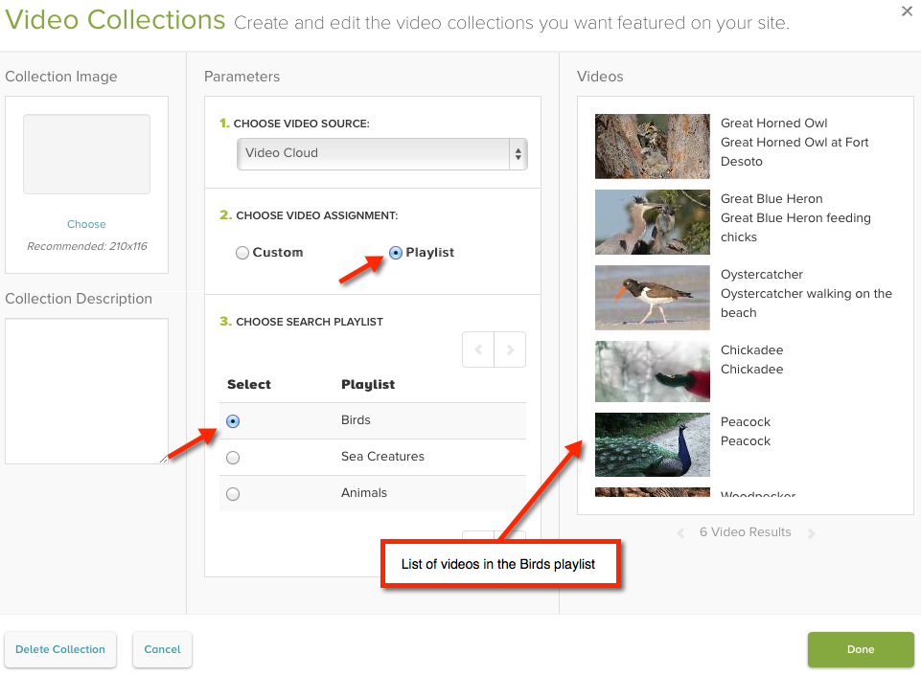
Using a Playlist Video Assignment
Select Playlist
List of playlists in your Video Cloud account will display
Select a Playlist to use
Video list will display videos in that playlist

Slide 33
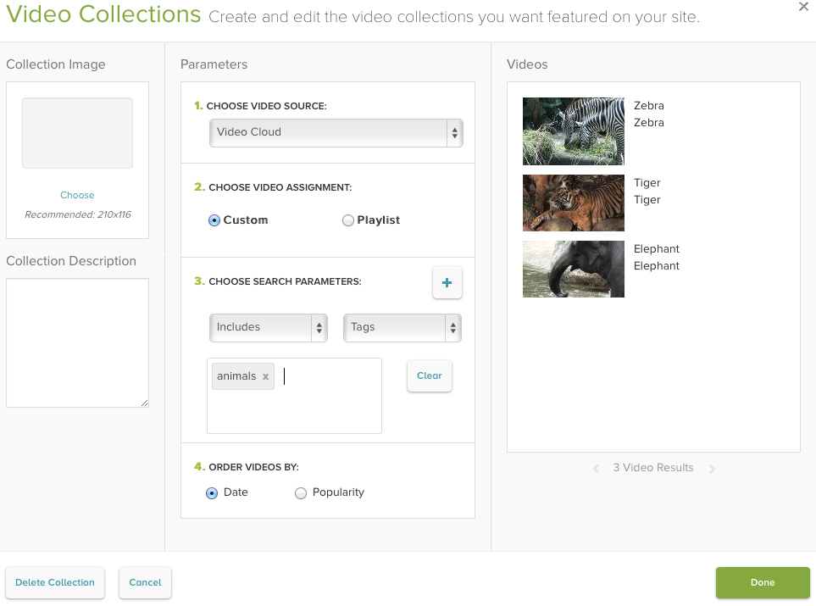
Using a Custom Video Assignment
Select Custom
Add search parameters to select videos for the collection
Multiple search parameters are supported
(Optional) Order videos

Slide 34
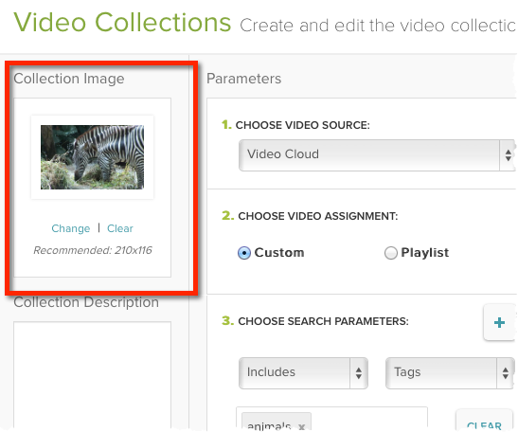
Using a Collection Image
Select an image to use to represent the collection

Slide 35
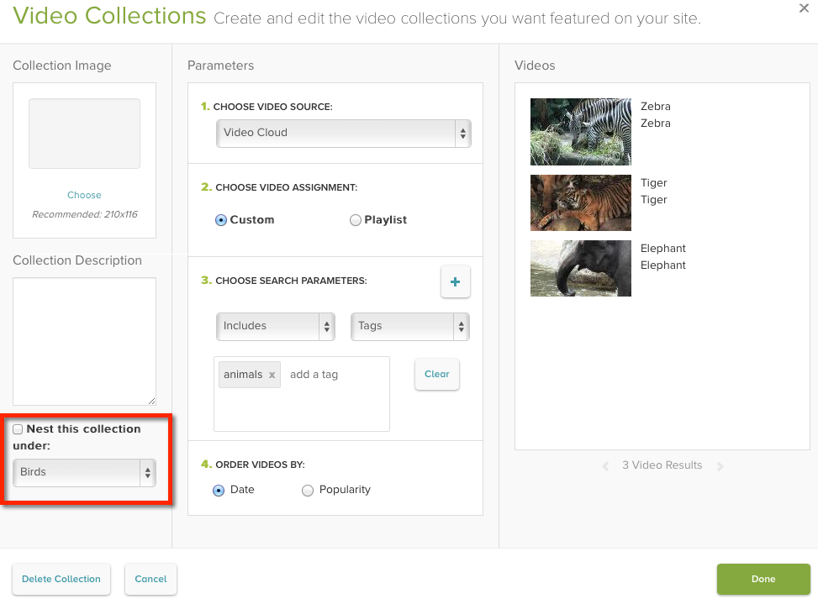
Nesting Collections
Nest a collection under another collection
Not all templates support nested collections

Slide 36
Setting Site Properties

Slide 37
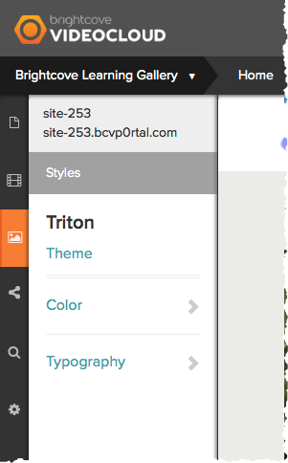
Setting Styles
Click the Styles icon
Change:
Theme
Color
Fonts

Slide 38
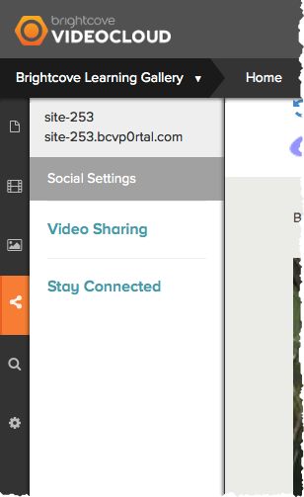
Setting Social Settings
Click the Social Settings icon
Video Sharing
Stay Connected

Slide 39
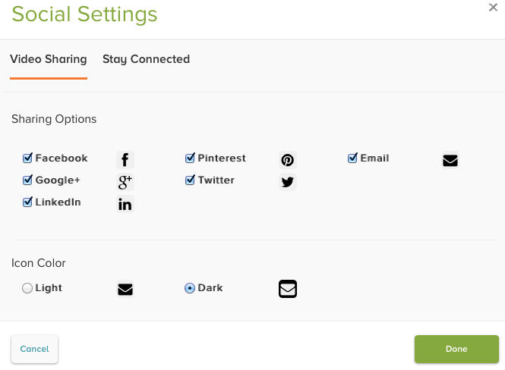
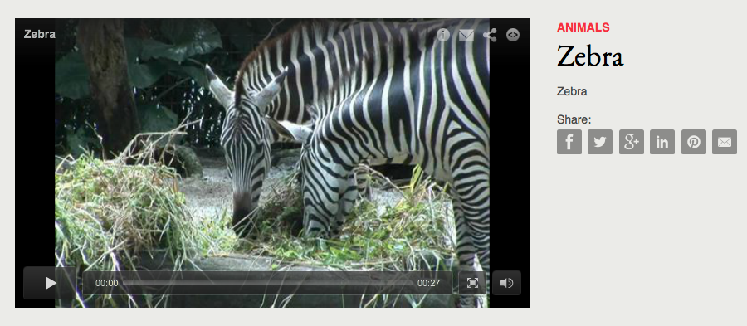
Setting Video Sharing Settings
Video Sharing settings allow viewers to share your videos out to social media sites

Slide 40
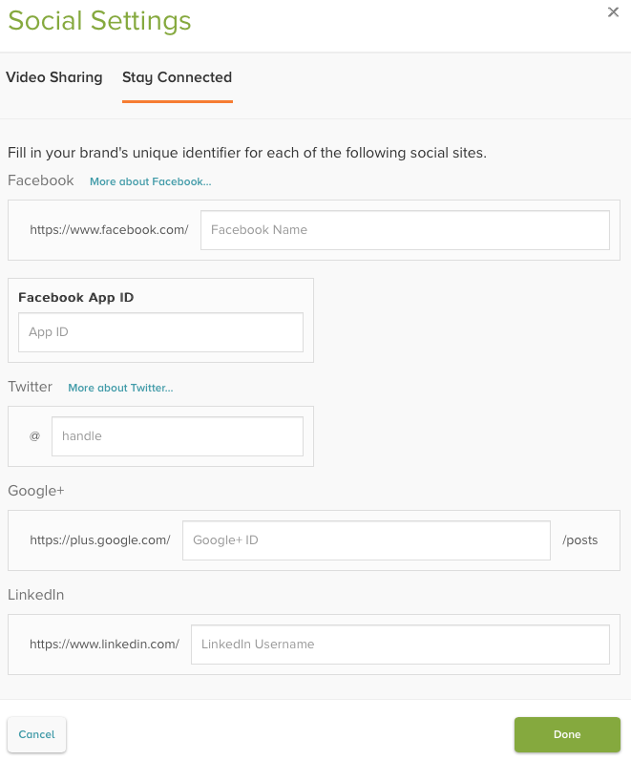
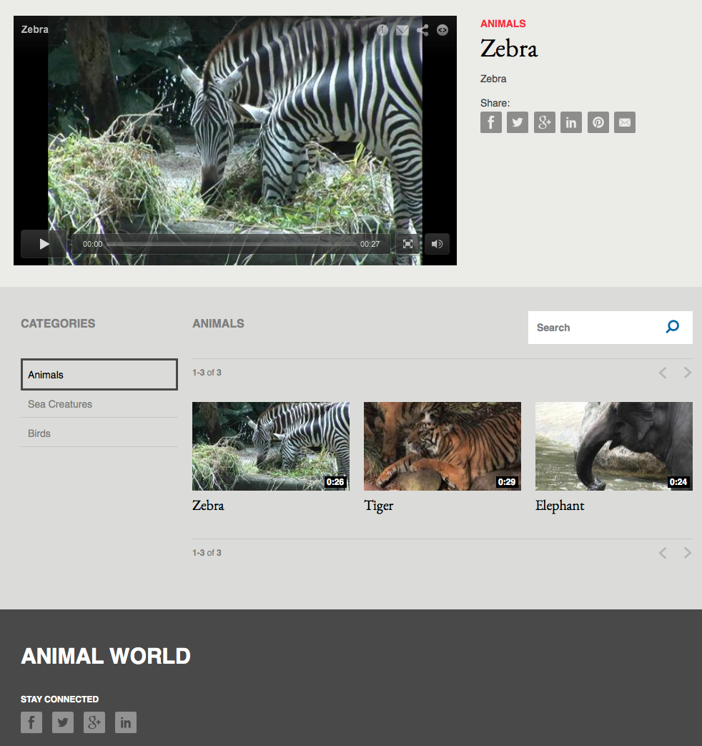
Setting Stay Connected Settings
Stay Connected settings provide viewers with easy access to your social media sites

Slide 41
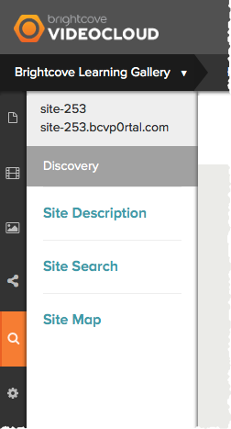
Setting Discovery Settings
Click the Discovery icon
Site Description
Site Search
Site Map

Slide 42
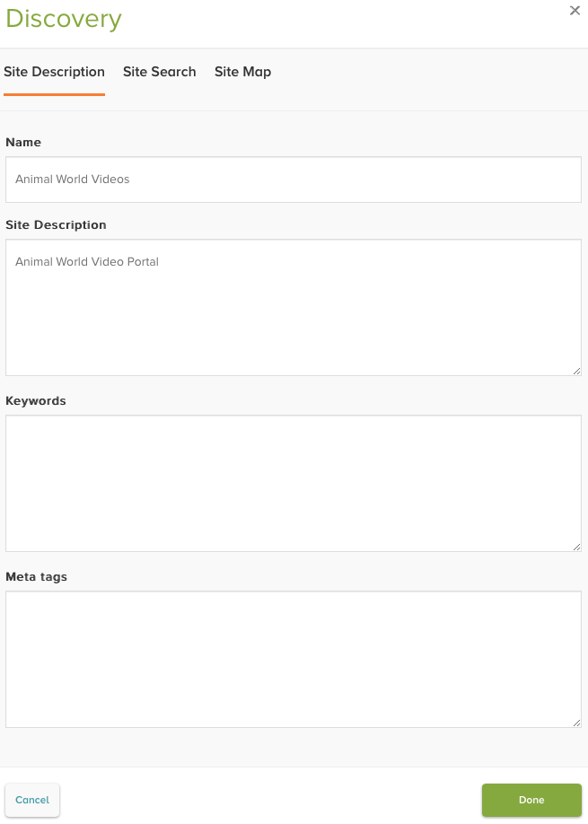
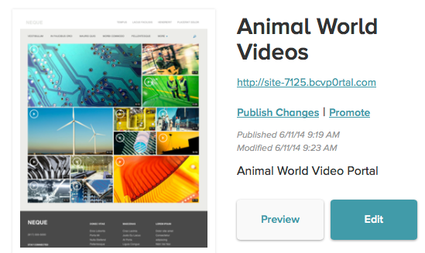
Setting Site Description Settings
Set the site name, description and keywords
Name
Appears in browser title
Added to site thumbnail
Site Description
Added to site thumbnail
Keywords
Added to <meta name=“keywords”> for page
Meta tags
Used to add additional meta tags for the site

Slide 43
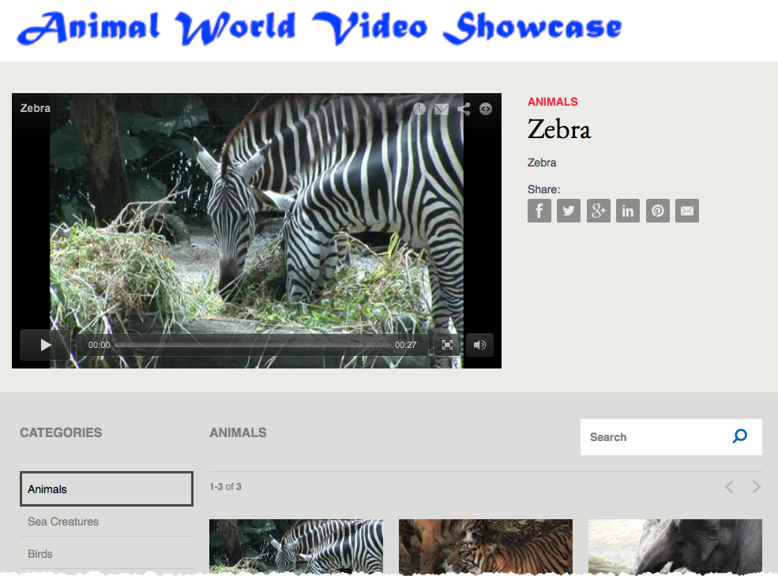
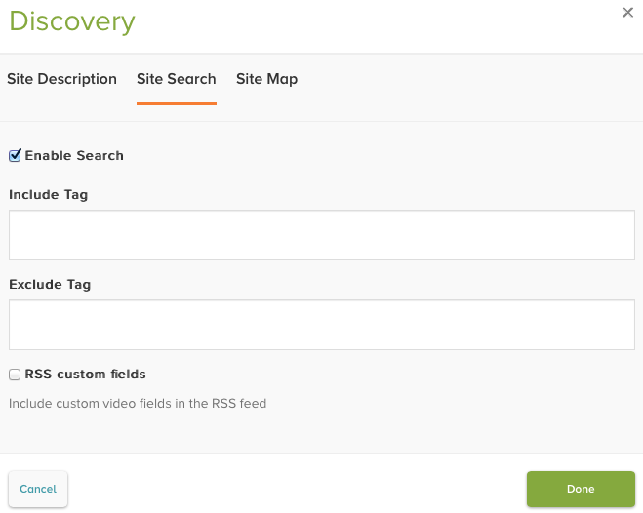
Setting Site Search Settings
Enable the ability for users to search the site
Include Tag – videos must also have this tag to be returned in search results
Exclude Tag – videos with this tag will be excluded from search results
Only a single tag is supported

Slide 44
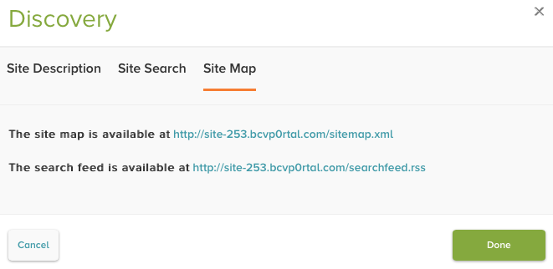
Viewing Site Map and Search Feed URLs
Site map can be downloaded and submitted to search engines
Search feed can be used by most search engine software as a way to add Gallery content to search results
Links are not active until the site has been published

Slide 45
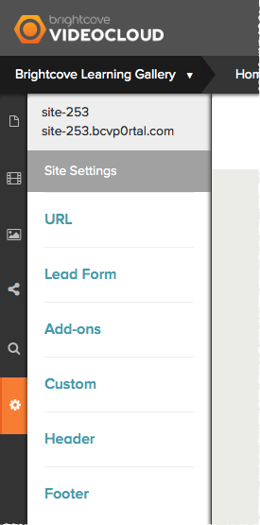
Setting General Settings
Click the Settings icon
URL
Lead Form
Add-Ons
Custom
Header
Footer

Slide 46
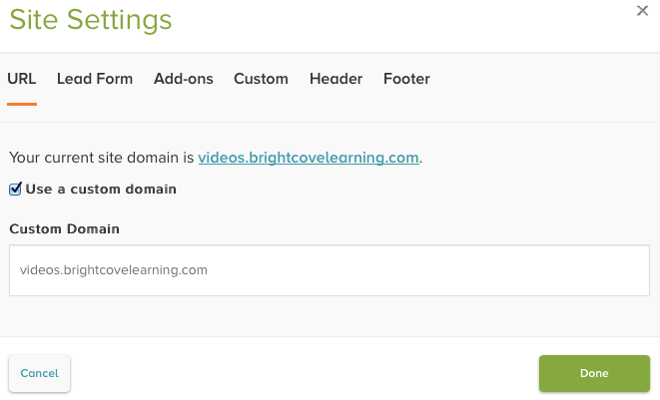
Setting URL Settings
Used to access the site using a custom domain
To use a custom domain you must:
Configure the domain settings in Gallery
Configure a CNAME record for the domain
Domain to access the site at

Slide 47
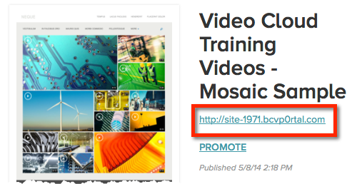
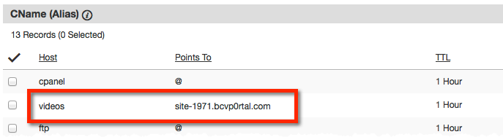
Configuring a CNAME record
Process will be different depending on the domain registrar
Example:
To host site at videos.mysite.com
Set Host to videos
Set Points To to the Gallery site URL
Site URL appears with the site thumbnail
DNS changes may take up to 48 hours to appear

Slide 48
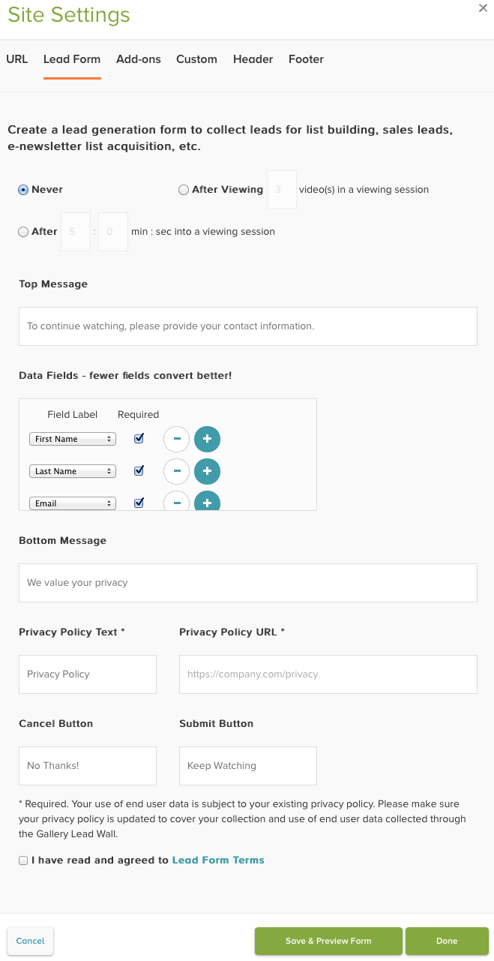
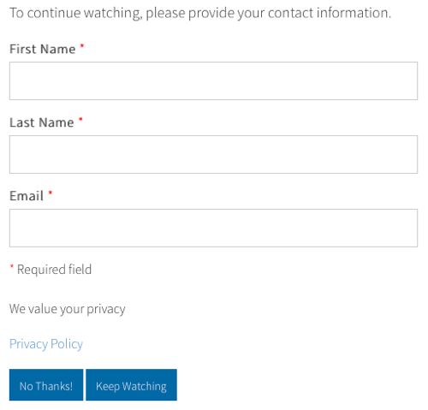
Lead Form Settings
Create lead form to capture viewer information as videos play

Slide 49
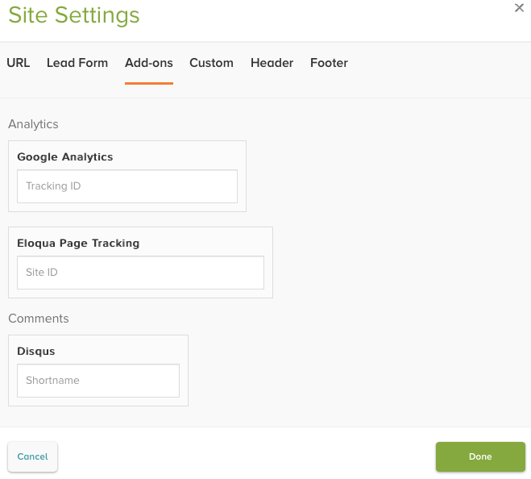
Add-On Settings
Provides the ability to integrate with third-party applications
Not all templates support all the add-ons

Slide 50
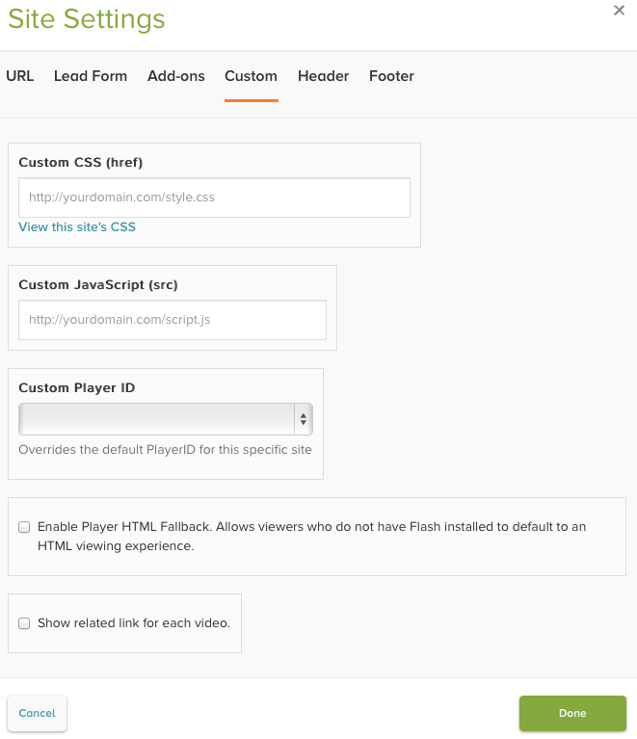
Custom Settings
Custom JavaScript or CSS files can be used to customize the site
A custom player for the site can be selected
This player overrides the player selected at the account level
Enable HTML fallback for the site
Show related link

Slide 51
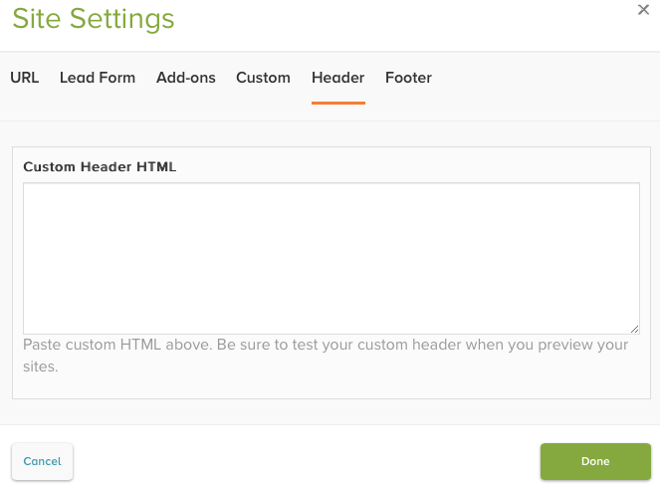
Custom Header and Footer
Provide HTML to use for the site header and/or footer
Provides the ability to customize your Gallery site so it more closely matches the look and feel of your corporate sites

Slide 52
Previewing & Publishing a Site

Slide 53
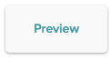
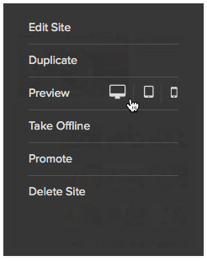
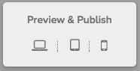
Previewing a Site
Click PREVIEW from Gallery homepage
Hover over the site thumbnail and click Preview
Click Preview & Publish inside of the Gallery Site Editor

Slide 54


Publishing a Site
Click Publish from Gallery homepage
Hover over the site thumbnail and click Publish Site
Click Preview & Publish inside of the Gallery Site Editor

Slide 55


Publishing a Site
Publishing a site generates a static URL for the site so viewers can access it

Slide 56

Publishing a Site
If you make any changes to the site, make sure to republish

Slide 57
Gallery Reports

Slide 58

Gallery Reports
Download lead form data
You must be an Administrator to download data

Slide 59
Additional Resources

Slide 60



Online Training and Quick Start Guide
Gallery Essentials Training On-Demand
Recorded version of Gallery Essentials training
http://bit.ly/bcgallery
Quick Start to Gallery
Set of hands on steps you can work through on your own to build a Gallery site
http://bit.ly/qsgallery
Notes:
60
60

Slide 61

Additional Training Courses
Brightcove.com > Services > Training
Notes:
61
61

Slide 62

Support Documentation
Support.brightcove.com
Notes:
62
62

Slide 63

Training Videos
Notes:
63

Slide 64

Online Support
Notes:
64
64

